Slide 1


Hamza: AI Personal Assistant
Submitted By
MD Parvez Mussaruf Registration No: 18502003564 Session : 2018-2019 |  | Rifatul Mostafa Registration No: 18502003593 Session : 2018-2019
Department of Computer Science and Engineering (CSE) Institute of Science and Technology (IST) 02 June, 2024

Slide 2
Content List
Introduction
Motivation
Objective
Existing System Overview
Drawbacks of Existing System
Work Flow Diagram
Level- 0 DFD
Level- 1 DFD
Use Case Diagram
Proposed System Features
Platform Overview

Slide 3
Content List
Implementation
Testing
Comparison
Conclusion
Future Work

Slide 4
Introduction
“Hamza: AI Personal Assistant” uses the latest AI and natural language processing technology to create a smooth and interactive experience.
Hamza can understand and respond to voice commands. It can do many tasks, like answering questions, managing your schedule, playing music, and searching the web.

Slide 5
Motivation
Boost Efficiency: Hamza saves time by streamlining tasks and providing quick, accurate responses.
Natural Interaction: With advanced speech recognition, Hamza offers easy to use, user-friendly experience.
Personalized Help: Hamza gives smart, personalized answers based on what you need, making your experience better.

Slide 6
Objective
To Automate Daily Tasks: Streamline routine activities through efficient voice commands.
To provide Seamless Interaction: Offer a user-friendly and intuitive interface with advanced speech recognition.
To Deliver Personalized Assistance: Adapt to individual user needs with intelligent, context-aware responses.
To Enhance Productivity: Save time and increase efficiency by managing schedules and accessing information quickly.

Slide 7
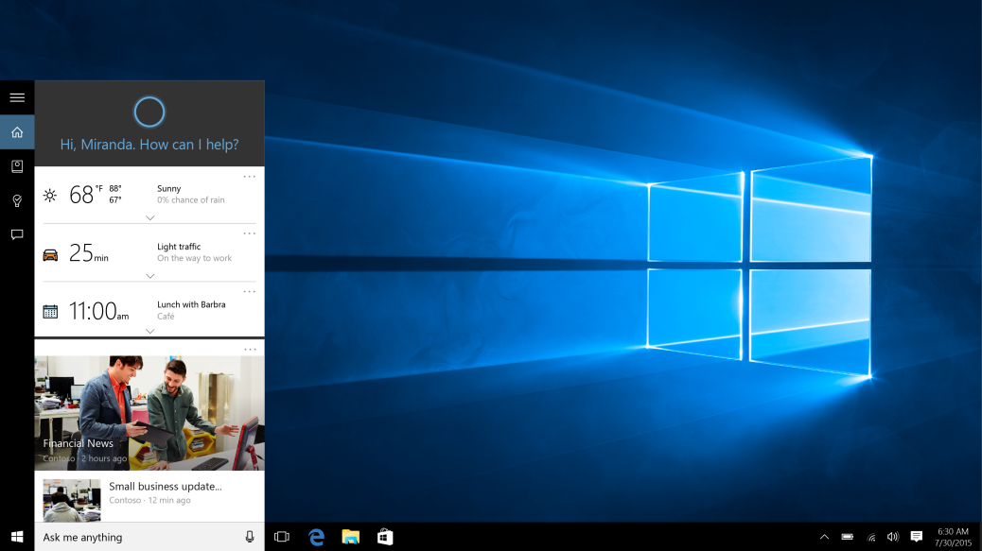
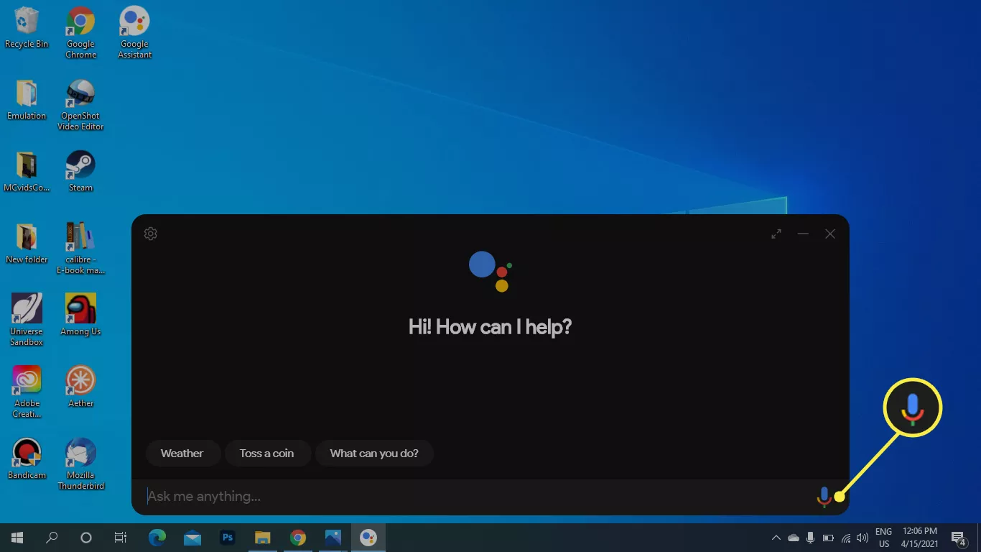
Existing System Overview
Cortana (Microsoft):
Google Assistant:

Slide 8
Drawbacks of Existing System
Primarily integrated into Windows operating systems, with limited support on other platforms. (Cortana)
Deep integration with Microsoft services but limited third-party service integration. (Cortana)
Offers some customization options, but these are relatively limited compared to open-source alternatives.(Google assistant)
Response time can be slow, especially when handling complex queries or accessing third-party services.(Google assistant)

Slide 9
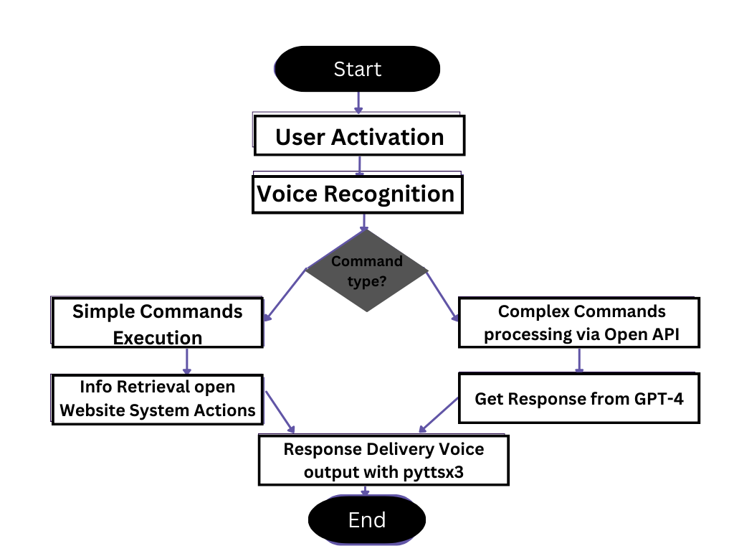
Proposed System Design
Fig: Work Flow Diagram

Slide 10
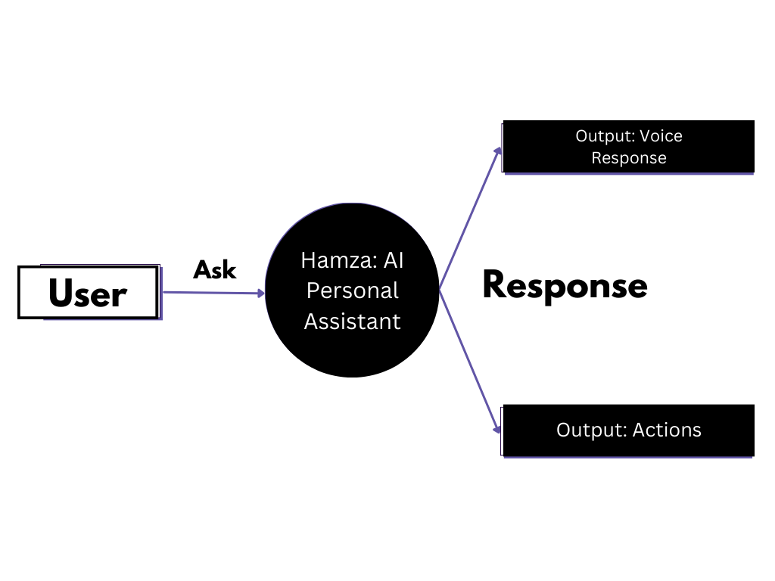
Proposed System Design
Fig: Level 0 DFD

Slide 11
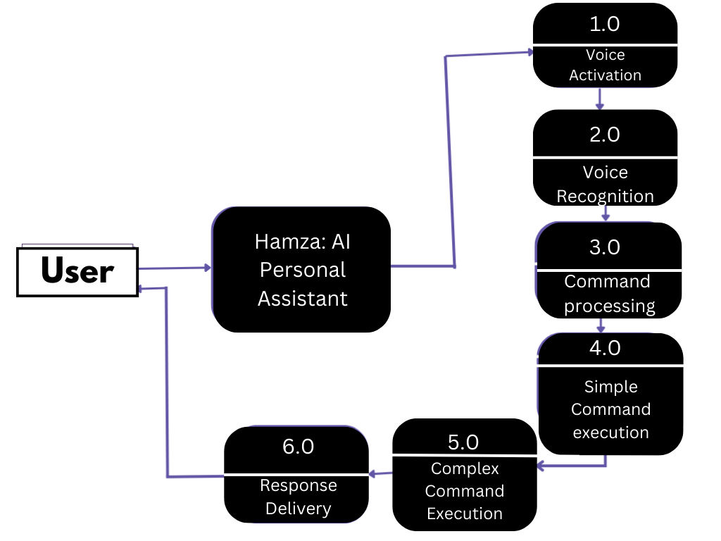
Proposed System Design
Fig: Level 1 DFD

Slide 12
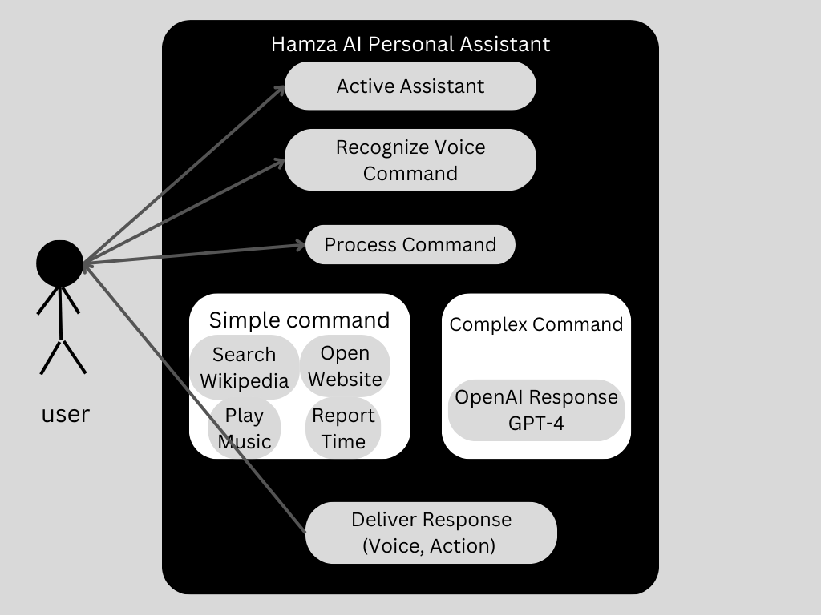
Proposed System Design
Fig: Use Case Diagram

Slide 13
Proposed System Features
Recognizes specific voice commands ("Hi, Hamza", "Hello, Hamza") to activate the assistant.
Captures and processes voice commands from the user.
Determines whether the command is simple (e.g., open website, play music) or complex (e.g., natural language query).
Simple Command Execution by opening Wikipedia Search, Open Websites, Play Music, Report current Time.
For complex command uses the OpenAI API (e.g., GPT-4) to handle complex natural language queries and provide detailed responses.
Provides feedback if the voice command is not recognized or if the speech service is down.
Speaks out the response or performs the requested action.

Slide 14
Required Tools
SL | Hardware | Software
01 | OS independent | Python 3.12.3
02 | Processor Base Frequency of 1.8 GHz or higher. | Pycharm 2024.1.2
03 | 4 GB RAM or more. | OpenAI API
04 | 10 GB of available disk space or more.
05

Slide 15
Platform Overview
SL | Backend | Frontend
01 | Python | Tkinter GUI
02 | OpenAI API | Voice Input & output
03
04
05

Slide 16
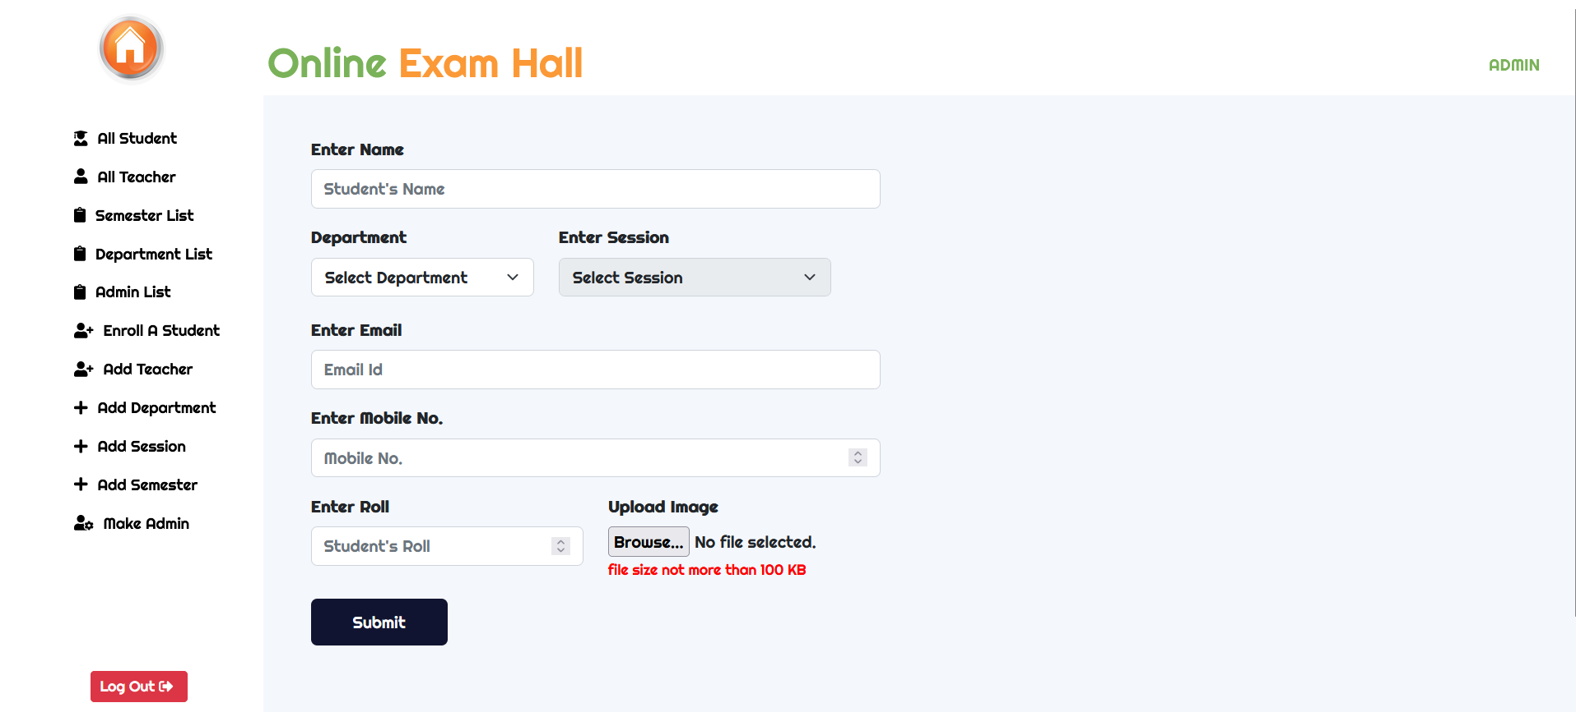
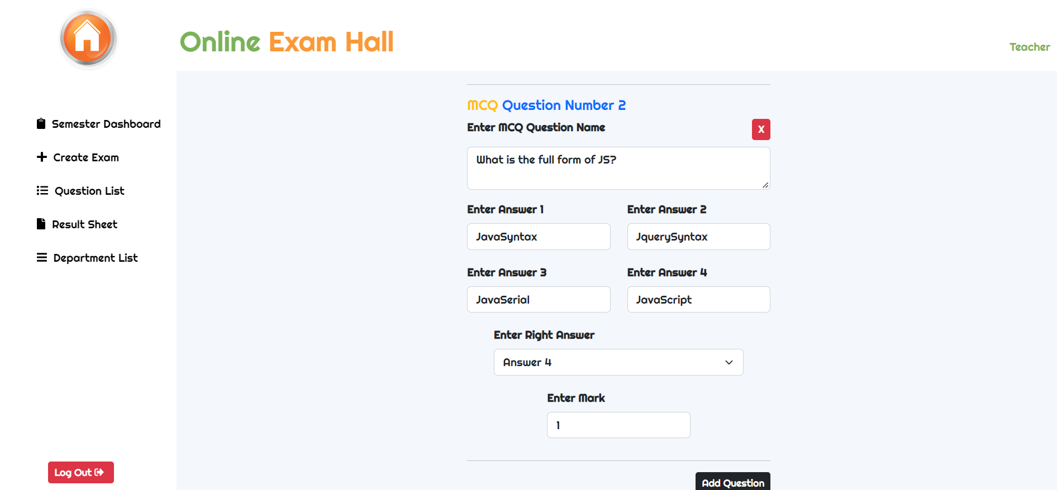
Implementation
Here we create a profile.
Fig: Profile creation page
Here we create a question.
Fig: Question creation page

Slide 17
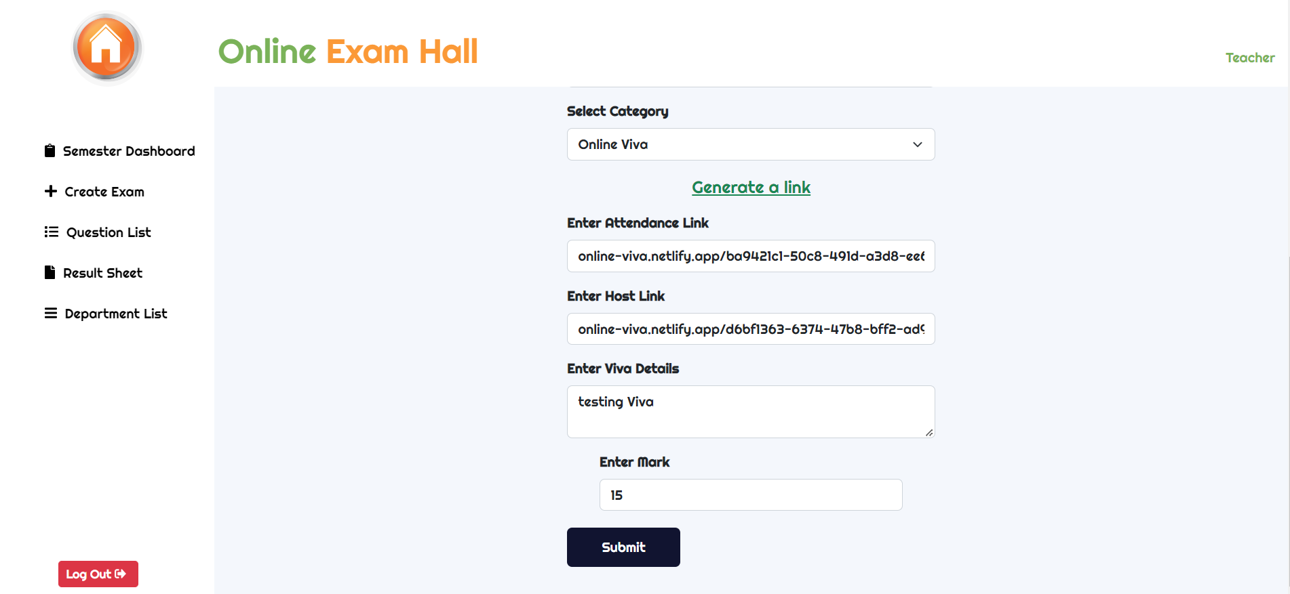
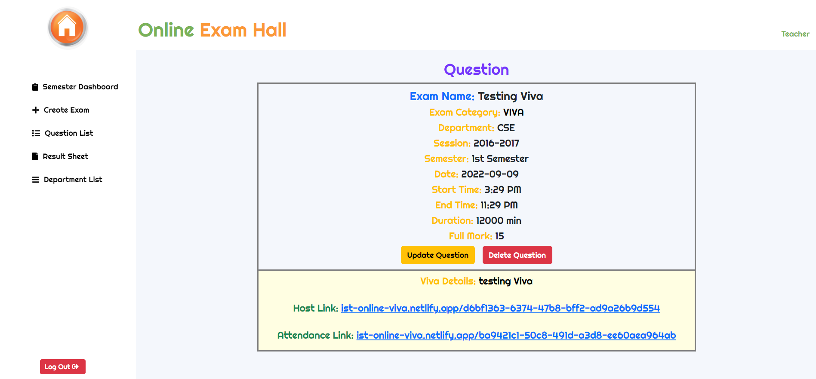
Implementation
Here we create an online viva with video calling system.
Fig: VIVA creation page
Here we can see the created viva link of video calling system.
Fig: VIVA details page

Slide 18
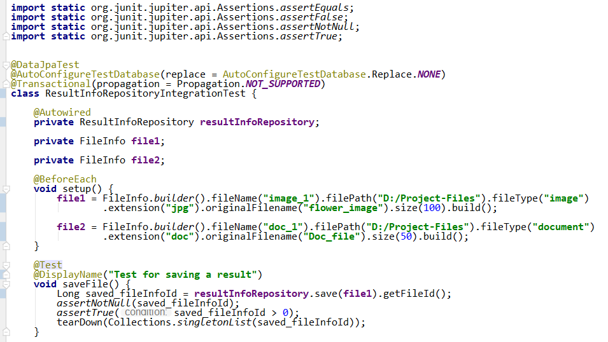
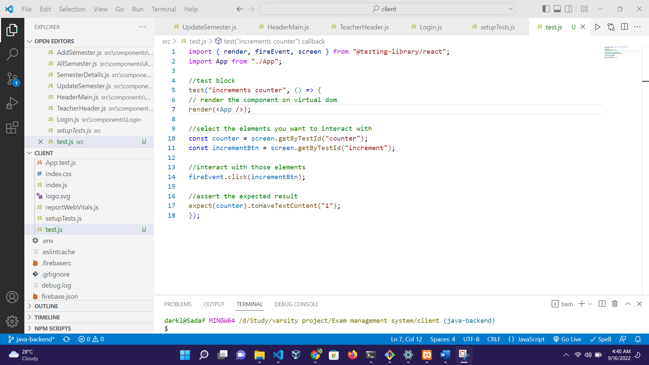
Test Result
Fig: Unit test case of Result Repository
Fig: Unit test case of App component

Slide 19
Comparison
Case | Existing Systems |  | Proposed System
 | Cortana | Google Assistant | Hamza
Voice Activation | Yes | Yes | Yes
Custom Application Integration | No | No | Yes
GPT-4 supported | No | No | Yes
Customization | No | No | Yes
Paid | No | No | No
AI integration | No | Yes | Yes

Slide 20
Conclusion
. Advanced AI Integration of voice recognition and natural language processing technologies for efficient personal assistance.
Complex Command Processing by engages in meaningful interactions using the OpenAI API to handle complex natural language queries.
Enhanced Productivity which simplifies daily routines, enhancing productivity and efficiency for users.
Versatile Functionality performs a variety of tasks including opening websites, searching for information, playing music, and more.

Slide 21
Future Work
Improve Natural Language Processing to enhance better understand and handle diverse user inputs and contexts.
Voice Personalization to allow users to customize the assistant's voice and responses to create a more personalized interaction experience.
Utilize Machine Learning algorithm for Improve Accuracy of voice recognition and command processing efficiency.
Develop Offline Capabilities for essential tasks, ensuring the assistant can operate without an internet connection.
Enhanced Security and Privacy when handling sensitive information.

